Slide 2
Evolution of Ethnogeriatrics and Selected Qualitative Outcomes
Melen R. McBride, PhD, RN, FGSA
Stanford Geriatric Education Center Stanford University School of Medicine

Slide 3
Learning Objectives After the session, participants will be able to:
Define ethnogeriatrics;
Identify at least 3 ethnogeriatric programs initiated at SGEC;
Describe briefly the collaboration between the University of Alaska Anchorage and SGEC specific to Cohort Historical Analysis.

Slide 4
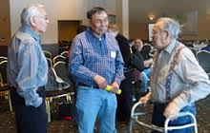
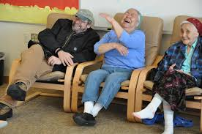
Definition: Ethnogeriatrics
A subspecialty in gerontology/geriatrics that focus on the interrelatedness of aging, health and culture particularly for older adults from diverse ethnic/racial communities.

Slide 5
Sources of
Scientific Knowledge

Slide 6
Driving Factors
persuasive power of demographic projections for the aging racial/ethnic populations or ethnogeriatric imperative (Yeo, 2009),
high prevalence of functional impairments and multiple chronic illness in later life,
limited access/utilization of healthcare resources, and
lack of geriatric trained professionals in health and behavior disciplines with knowledge/skills in ethnic eldercare (IOM, 2002; 2008, Yeo, 2009)

Slide 7
SGEC Mission
To improve quality of healthcare and quality of life of diverse older adults in the U.S. through education of healthcare professionals on health and social service needs of older people including ethnic minority older adults and their families, with a special emphasis on the cultural context of these needs.” (http://sgec.stanford.edu/mission.htm)

Slide 8
SGEC Initiatives for Ethnogeriatrics
Identify scientific content
Create ethnogeriatric bibliographic database
Develop ten core competencies
Produce Core Curriculum
Design/offer training programs
Assist healthcare programs to infuse ethnogeriatrics in their curricula
Disseminate results of SGEC activities

Slide 9
Evolution of Cohort Analysis
Competency No. 7
Explain the importance of cultural and historical experiences (e.g., historical trauma from racism and discrimination) and describe their effects on the older client’s help-seeking behaviors, and their access and utilization of health care services, including emergency preparedness.
http://sgec.stanford.edu/competencies.html

Slide 10
Cohort Experiences
Socio/historical events shared by cohorts (either a generation or a group) through stages in their lifespan, e.g. immigration experiences, socio-political events, etc. that may have influenced the ethnic elder’s perception, attitude and relationship with formal systems.
Historical events experienced by cohorts of older adults provide insights on how they influence the elders’ values, health beliefs, illness behaviors, self-image, degree of trust, and expectations of providers.
Yeo, G., McBride, M., Hikoyeda, N., Soo-Young, L. & Hendrix, L., 1998; McBride, M. & Rosich, R. 2013

Slide 11
Cohort Analysis
Examination of historical profiles and show how cohorts move concurrently through developmental stages (e.g., infancy, childhood, young adulthood, adulthood, late adulthood, elderhood) and historical periods.
Educational tool to increase cultural awareness of health professionals; helps organize history taking and recording health data in clinical settings.

Slide 12
Elements of Cohort Analysis
Significant historical events for each period
Age periods for a group of ethnic elder divided into 1 or 2 decades
Chronological historical chart
Events and periods chart

Slide 13
Application of Cohort Analysis ___________________________________
EMERGENCY/DISASTER PREPAREDNESS

Slide 14
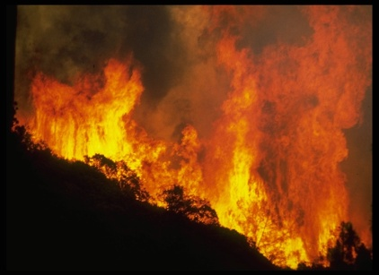
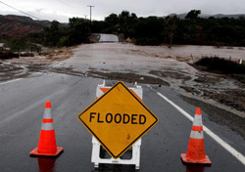
Racial/Ethnic Minority Elders
Limited English Proficiency, Limited Health/Functional Literacy
Visually Impaired
Hearing impaired
Cognitively impaired
Physically limited and/or disabled
Chronic mental illness
Dependent upon medical care, equipment, and/or medications

Slide 15
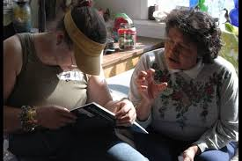
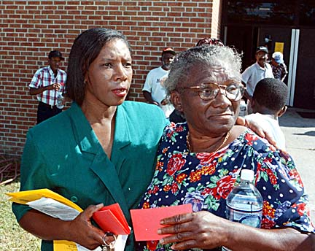
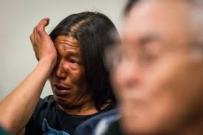
Cohort Experiences 1920-1939,1940-1959, 1960-1989, etc..
What has happened in the past that may have triggered an important change in the older person’s beliefs, attitudes, and/or lifestyle?

Slide 16
Cohort Experiences
Native Americans Relocation – Trail of Tears
American World War II – historical trauma
Alaska Natives in the Aleutian Islands forced relocation
Japanese American internment camps
Tuskegee experiments on African Americans
Vietnam War and refugee camps
Storms: Katrina, Sandy
Boarding Schools

Slide 17
Focus Group Outcomes: Seeking Help in Disaster
Passamaquoddy Community ~ We will never evacuate our homes. The last time we did, they left us to die of TB. We won’t accept government help. Remember the blankets with smallpox? That was the help they gave.
Somali Community ~ Share a shelter with the men, are you kidding, don’t you remember what happened to us in the refugee camps? Domestic violence is common especially in disasters we need to protect our daughters.
Vietnamese Community ~ Whenever a police shows up at your house, there will be a problem. That’s why I’m afraid. Just like the police officers in Vietnam.
Matthew, A.B. & Kelly, K., 2008; Lippmann, A., 2009

Slide 18
Application of Cohort Analysis ___________________________________
INFORMMATION RESOURCE FOR CLINICIANS

Slide 19
http://www.bonshome.org/diversity.htm
Diversity, Healing and Health Care..
A web-based resource for clinicians who work with patients whose cultures and religions are different from their own.
Greetings and Introductions | Religious Beliefs and Healing | Cohort Life Events
Scenarios & Definitions.. | Introduction & HomePage. | Program Information & Bibliography
 | Survey About Use | The menu above provides web-based pages. Click here for a menu to view pages in PDF format. .
Welcome Diversity, Healing, and Health Care, a cooperative project of On Lok SeniorHealth and the Stanford Geriatric Education Center (Division of Family and Community Health, Stanford University School of Medicine), and partially funded through a grant from the Bureau of Health Professions, U.S. Department of Health and Human Services.

Slide 20
Application of Cohort Analysis ___________________________________
TEACHING and RESEARCH

Slide 21
Adaptations of Cohort Analysis
2010, Grave, Rosich, McBride, George, & La Belle. Health and Health Care, Alaska Native Older Adults, eCampus Geriatrics, http://geriatrics.stanford.edu
2010, Cohort Historical Analysis Tool (CHAT) and Cohort Self-Assessment Tool worksheet (CSAT), eCampus Geriatrics http://geriatrics.stanford.edu
2012-13, McBride & Rosich, Cohort Analysis and Life-Span Stages Linkage With Avatar-Case Study, AGHE & Diversity Rx conferences
2014-15, McBride & Rosich, Cohort Historical Analysis and Developmental Assessment Tool (CHADAT), a worksheet for a the SGEC Faculty Development in Ethnogeriatrics and Health Literacy.

Slide 22
APPLICATION of Cohort Analysis ___________________________________
FUTURE RESEARCH
Refinement of CHADAT

Slide 23
Cited References
1998, Yeo, Hikoyeda, McBride, Soo-Young, Edmonds, & Hendrix, Cohort analysis as a tool in ethnogeriatrics: Historical profiles of elders from eight ethnic populations in the United States. Working Paper #12, 2nd Edition, Stanford, CA: Stanford Geriatric Education Center.
2013, McBride & Rosich, Cohort Analysis and Life-Span Stages Linkage With Avatar-Case Study, AGHE & Diversity Rx conferences.
2013, Napier, Diversity, Healing and Healthcare, author and webmaster, email: bdnapier@concast.com

Slide 24
Cited References
2008, Matthew & Kelly, Disaster Preparedness Communities: Lessons Learned from Recent Catastrophic Events and Their Relevance to Latino and Asian communities in Southern California. A Tomas Rivera Policy Institute and Asian Pacific American Legal Center Report, Los Angeles, CA
2009, Lippmann, Vulnerable Populations and Disaster Preparedness: Developing Culturally Competent Preparation for Vulnerable Populations in Response to Disaster Threats, Dissertation.

Slide 25
THANK YOU. HAPPY HOLIDAYS. ___________________________________
Melen McBride, PhD, RN, FGSA
Email: mcbride@stanford.edu

