Slide 1
Geriatric Emergency Preparedness and Response (GEPR) Webinar Series 2015 Strengthening Preparedness and Resilience capabilities in Vulnerable Older Populations Session Two

Slide 2
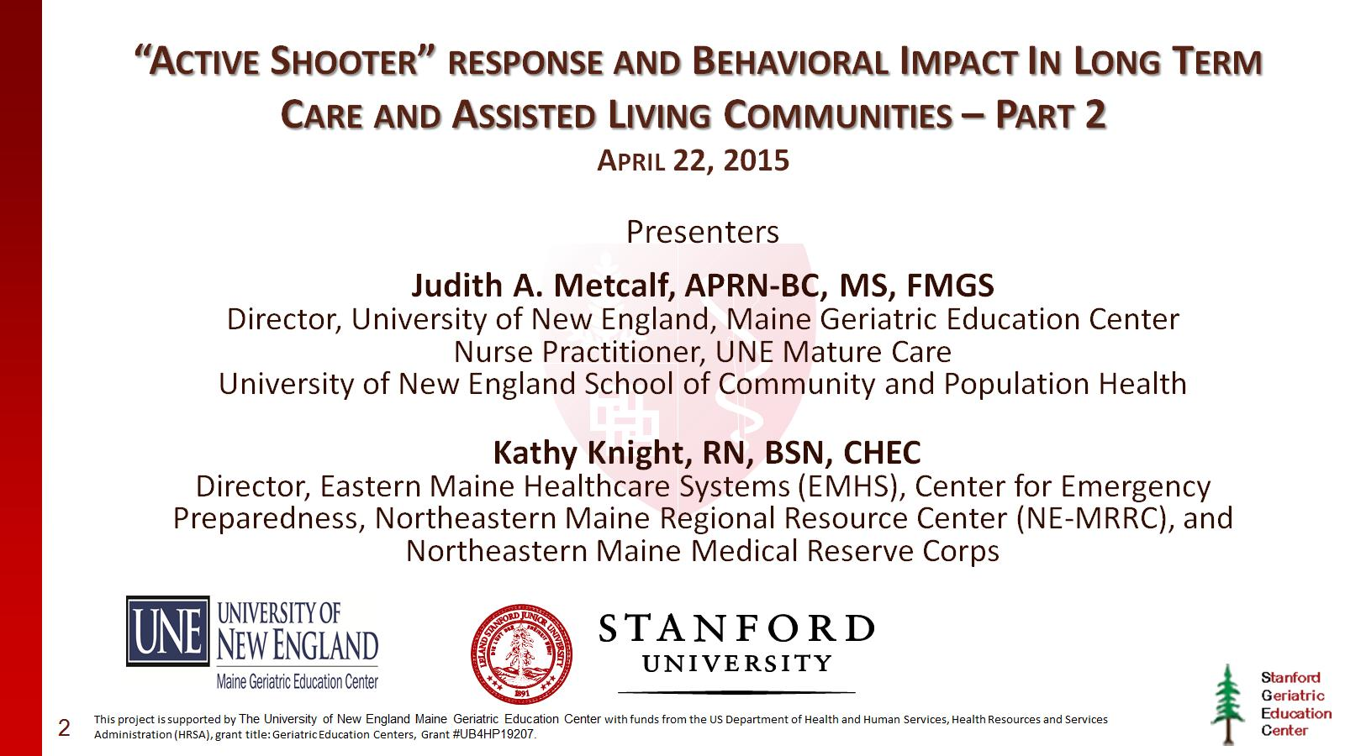
“Active Shooter” response and Behavioral Impact In Long Term Care and Assisted Living Communities – Part 2 April 22, 2015

Slide 3
Judith A. Metcalf, APRN, BC, MS

Slide 4
Kathy Knight, RN, BSN, CHEC

Slide 5
Background

Slide 6
Background

Slide 7
Background

Slide 8
Learning Objectives

Slide 9
What Would You Do?

Slide 10
What Would You Do?

Slide 11
What Would You Do?

Slide 12
Could it happen to you?

Slide 13
Content

Slide 14
Active Shooter Definition

Slide 15
FBI Report (Published September 16, 2013)

Slide 16
Overview of Findings

Slide 17
Incidents Annually

Slide 18
Location Categories

Slide 19
Active Shooter Venues NYPD

Slide 20
Active Shooter Venues

Slide 22
Security & Workplace Violence

Slide 23
Workplace Violence

Slide 24
Most Likely Healthcare Venues

Slide 25
Hospital-Based Shootings in the U.S.-2000-2011

Slide 26
Hospital Based Shootings

Slide 27
Recent Long Term Care/Assisted Living Active Shooter Events

Slide 28
Carthage Nursing Home Shooting

Slide 29
Duration of Active Shooter Event

Slide 30
Preparing for an Active Shooter Situation

Slide 31
Phases of Emergency Management Cycle

Slide 32
Mitigation & Prevention Phase

Slide 33
Preparedness Phase

Slide 34
Purpose of Response Plan

Slide 35
Principles Used in Plan Development

Slide 36
Acronym Soup

Slide 37
Development of An Emergency Operations Plan (EOP)

Slide 38
Conduct Training and Exercises

Slide 39
Clinical Training Affecting Healthcare Response

Slide 40
Untrained Personnel

Slide 41
Training Commitment

Slide 42
Trained Personnel

Slide 43
Personal Responsibilities of Employees

Slide 44
Window of Life

Slide 45
Maintain Situational Awareness

Slide 46
Preventing an Active Shooter Situation

Slide 47
Characteristics of an Active Shooter Event

Slide 48
Common Characteristics Of An Active Shooter

Slide 49
Triggers Do Exist! “People Don’t Just Snap”

Slide 50
Impact of Personal Interactions

Slide 51
Individual Violent Process

Slide 52
Workplace (Non-Terrorist) Shooters

Slide 53
Active Shooter Behavior Pattern

Slide 54
Active Shooter Exercises

Slide 55
“Take Home” Message

Slide 56
Active Shooter Response

Slide 57
Response Phase

Slide 58
Be Alert and Report Suspicious Situations

Slide 59
Response Processes

Slide 60
Response In An Outpatient Setting or Business Occupancy

Slide 61
Personal Response (Ideas)

Slide 62
Fight or Taking Out the Shooter

Slide 63
Law Enforcement Response

Slide 64
Arrival of Officers and Rescue Teams

Slide 65
When Law Enforcement Arrives

Slide 66
Clearing the Building

Slide 67
Expectations for Law Enforcement

Slide 68
Recovery

Slide 69
Other Post-event Interventions

Slide 70
Impact of Active Shooter Event on Residents

Slide 71
Victim Recovery

Slide 72
Behavioral Health Resources

Slide 73
Thank you

Slide 74
Presenter Contact Information

Slide 75
Resource Links (# 1)

Slide 76
Resource Links (# 2)

